Slide 1

NYU IT PROJECT
Analyzing the Differences Between NYU Prince and Google Cloud
Ruining Sun (rs6565), Alankrith Krishnan (ak7380), Xifei Li (xl2715)

Slide 2
Prince Cluster VS Google Cloud
Outline
Ease of Access
User Interface: Login Process, Transferring Files, Jupyter Notebook Access
Storage Comparison
Disks on Prince vs Buckets and Disks
Hardware Comparisons
CPU, GPU and TPU
Time Taken
Deep Learning Benchmark, GAN MNIST, ImageNet, Sentiment Analysis, Glove
Access Times
Time taken to request resources on Prince and Google Cloud
Cost Reduction on Google Cloud
Committed Use Discount, Preemptible VM
Other Resources on Google Cloud

Slide 3
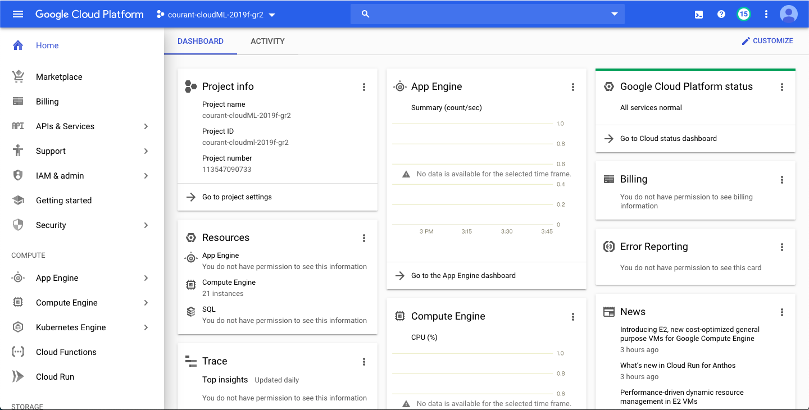
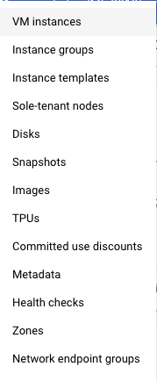
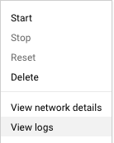
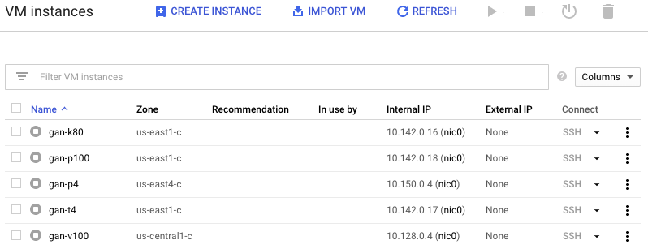
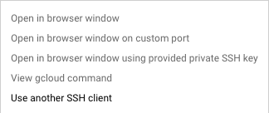
User Interface Comparison - Login
Prince Cluster
Access from Terminal Command Line:
In NYU Campus:
ssh NetID@prince.hpc.nyu.edu
Out of Campus:
ssh NetID@gw.hpc.nyu.edu
ssh NetID@prince.hpc.nyu.edu
Or Connecting to the NYU VPN
Google Cloud Platform
Access from Terminal Command Line:
Download Google Cloud SDK:
Essential tools for Google Cloud Platform
Create Instances from Website
gcloud compute config-ssh
ssh <instance name>.<instance region>.<project name>
Notes:
UI & Jupyter Notebook -> on Google Cloud, do need to download and install the SDK, can directly access and upload files to Google Cloud from the web (Xifei)
Command line
Jupyter Notebook
Transferring Data

Slide 4
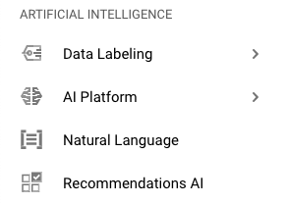
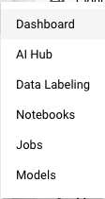
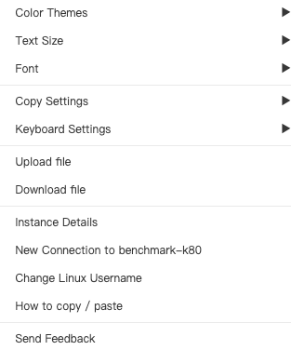
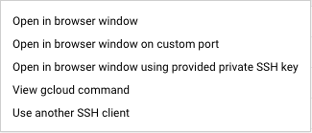
User Interface Comparison - Transfer & Jupyter Notebook
Prince Cluster
Access from Terminal Command Line:
Transferring Data: scp <file> NetID@prince.hpc.nyu.edu:/scratch/NetID
Running Jupyter Notebook:
Need a batch script -> copy run_jupyter.sbatch to scratch directory
$ mkdir /scratch/<net_id>/myjupyter
$ cp /share/apps/examples/jupyter/run-jupyter.sbatch /scratch/<net_id>/myjupyter
submit run-jupyter.sbatch to job scheduler
$ cd /scratch/<net_id>/myjupyter
$ sbatch run-jupyter.sbatch
Submitted batch job "job-number"
Google Cloud Platform
Access from Terminal Command Line:
Transferring Data: scp <file> <gcloud ssh link>:~
Running Jupyter Notebook:

Slide 5
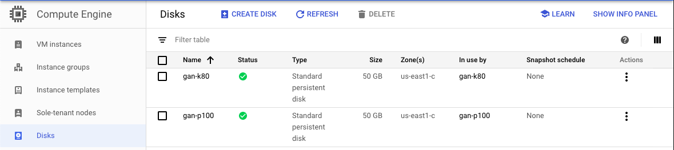
Storage Comparison
Prince Cluster - Disk
Google Cloud Platform - Disk & Buckets

Slide 6
Hardware Comparisons
 | Prince | Google Cloud
CPU architectures | Broadwell Haswell Skylake Ivy Bridge | Broadwell Haswell Skylake Sandy Bridge
GPU | NVIDIA V100 NVIDIA P100 NVIDIA K80 NVIDIA P40 | NVIDIA V100 NVIDIA P100 NVIDIA K80 NVIDIA P4 NVIDIA T4
TPU | NA | Provided
Notes:
on google cloud we can choose how many cpus, memory we want, and cpu architectures.
But we cannot choose cpu types.
ivy bridge has a better (graphics) capabilities than sandy bridge
tensor processing unit

Slide 7
Time Taken
Computer vision applications
Natural language processing applications
Deep learning Benchmark

Slide 8
GAN MNIST
IMAGENET
Prince |  | Google Cloud
k80 | 32m55.403s | k80 | 36m44.027s
p100 | 10m28.113s | p100 | 12m18.119s
v100 | 7m42.563s | v100 | 8m11.290s
p40 | 15m7.923s | p4 | 24m48.815s
 |  | t4 | 20m21.956s
Prince |  | Google Cloud
k80 | 89m29.484s | k80 | 92m54.042s
p100 | 54m25.404s | p100 | 25m18.315s
v100 | 57m8.564s | v100 | 19m31.144s
p40 | 55m38.370s | p4 | 59m25.841s
 |  | t4 | 52m55.920s
TensorFlow framework
50 epochs of training on MNIST dataset
PyTorch framework
10 epochs of training with Resnet-18 on 100K images
Notes:
people don’t require expensive GPUs very often. It’s likely that we were not sharing the GPUs with other users when we ran the jobs. But for Prince, we shared the expensive GPUs with others. This could affect the running time result. Since imgenet is a huge dataset, having an entire GPU could significantly improve the running time. While for smaller jobs, this improvement is not significantly.

Slide 9
Sentiment Analysis
GLOVE
Prince |  | Google Cloud
k80 | 34m38.850s | k80 | 40m17.536s
p100 | 14m2.130s | p100 | 23m21.367s
v100 | 19m48.365s | v100 | 21m32.302s
p40 | 20m37.119s | p4 | 29m50.465s
 |  | t4 | 24m22.108s
Prince |  | Google Cloud
k80 | 44m53.011s | k80 | 48m47.352s
p100 | 18m12.880s | p100 | 19m23.915s
v100 | 12m44.187s | v100 | 14m21.830s
p40 | 27m37.078s | p4 | 44m15.027s
 |  | t4 | 28m52.857s
PyTorch framework
50 epochs of training on IMDB listings
PyTorch framework
100 epochs of training on Scikit-learn (20 newsgroups)
Notes:
Sentiment Analysis: to analyze the sentiment of some specific words within a text file.
Glove: word embeddings model that compares the vector of words to analyze the similarity between them.

Slide 10
Deep Learning Benchmark
Prince |  | Google Cloud
k80 | 8m8.993s | k80 | 8m31.262s
p100 | 3m5.580s | p100 | 3m13.127s
v100 | 2m10.413s | v100 | 2m12.207s
p40 | 3m23.709s | p4 | 4m51.964s
 |  | t4 | 3m49.471s
Deep Learning Benchmark from GitHub.
MLPerf, MLBench and others require nvidia-docker/gpu based docker
20 epochs of training with VGG16, ResNet152 and DenseNet161 models and two frameworks - PyTorch and TensorFlow

Slide 11
Access Times
Average access times on Google Cloud is always ~2 minutes (this includes VM setup and driver installation time). If resources are not enough, the VM fails to create and you can create the VM in a different zone instead.
Access times on Prince vary based on the time of day and the day itself
Day | Time | Avg Access Time
Normal Days | Morning | Instant
 | Afternoon | ~2 minutes
 | Evening | ~5 minutes
 | Night | Instant
Heavy Days (Finals Week) | Morning | ~5 minutes
 | Afternoon | ~13 minutes
 | Evening | ~25 minutes
 | Night | ~20 minutes

Slide 12
Cost Reduction on Google Cloud
Committed Use Discounts
Ideal for workloads with predictable resources.
Paying for 1 year or 3 years.
Billed monthly.
Able to specify CPUs, memory, GPUs and storages.
Discount up to 57% for most resources.
Preemptible VM
Much less price than normal instances.
Lasts only 24 hours.
Compute Engine might preempt these instances.
Ideal for fault-tolerant app.
Notes:
Committed use discounts are ideal for workloads with predictable resources needs.
It can be terminated sooner due to system demands if it requires access to those resources for other tasks.
apps should be withstand possible instance preemptions

Slide 13
Other Resources/Benefits of Google Cloud
Cloud TPU’s - Deep Learning Accelerators
Superuser/sudo rights - Root Access
Docker/Kubernetes - Google Kubernetes Engine and Docker Containers
AI Platform - Auto ML/Predictions from Google based on your data
Easy JupyterLab access - Create notebooks with a VM attached
Static IP’s for instances if necessary
Premade images to use in VM’s for deep learning jobs

Slide 14
Conclusion
 | Prince | Google Cloud
Ease of Access |  | ✓
Storage |  | ✓
Performance | ✓ | ✓
Access Time | ✓ | ✓
Hardware | ✓ | ✓
Flexibility |  | ✓
Google Cloud is the choice in our analysis - much better User Experience, Buckets and Disk based storage, comparable performance and hardware, and the access times are constant and do not vary, and is much more flexible than Prince while offering more features.Can scale infinitely without needing to deal with the hardware directly (through the UI), making HPC admin work much easier for the future.

Slide 15
Questions?

Slide 16
Demo (if time permits)

